Slide 1
Net Sys & Apps
Week 22

Slide 2
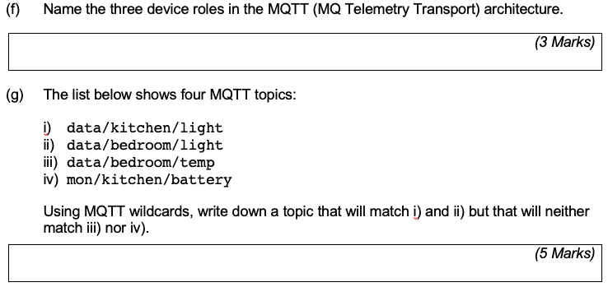
June 2018
Publisher, Subscriber, broker
Date/+/light

Slide 3
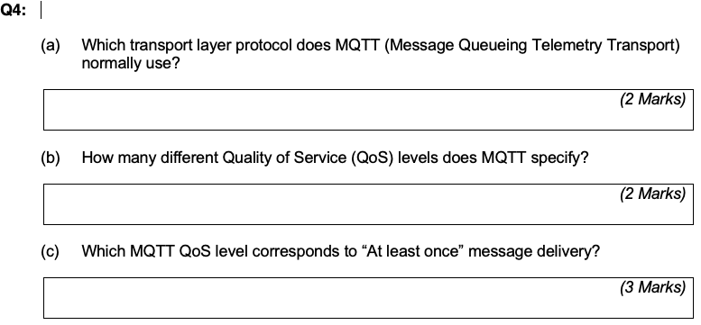
June 2019
TCP
3
QoS1

Slide 4
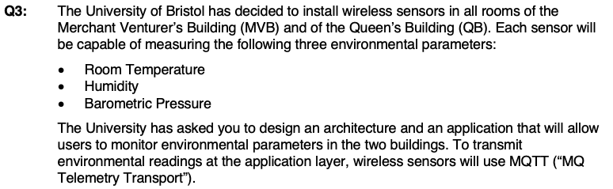
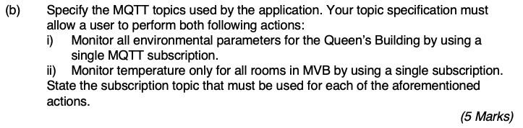
June 2016
uob/qb/#
Uob/mvb/temp/#
Uob/<building>/<sensor>/room
Uob/mvb/+/temp

Slide 5

June 2016
No. Publisher decides based on internal logic(ig. periodic or event-driven)

Slide 6

June 2016
We can use build-in reliabilitiy mechanism eg QoS1 or 2

